Slide 1
Employee salary prediction system
MENTOR: Dr N. Shirisha, Assoc.Prof.
BATCH NO:
TEAM MEMBERS:
2320030417- Sai Reethika
2320030027 – Saraf Swathi
2320030419 – Jakku Nikitha

Slide 2
Table of contents
ABSTRACT
INTRODUCTION
EXISTING SYSTEM
PROPOSED SYSTEM
OBJECTIVES
LITERATURE SURVEY
SOFTWARE REQUIREMENTS
HARDWARE REQUIREMENTS
FUNCTIONAL REQUIREMENTS
NON – FUNCTIONAL REQUIREMENTS
SYSTEM ARCHITECTURE
UML DIAGRAM
ACTIVITY DIAGRAM
MODULE DESIGN

Slide 3
Review – 2 comments addressed
1.Modules of the project need to analyse
2.Tools /Requirements gather

Slide 4
ABSTRACT
The Employee Salary Prediction System is an Artificial Intelligence based application designed to estimate employee salaries using Machine Learning techniques. The system analyzes historical HR data including attributes such as age, education level, job role, gender, and years of experience to predict salary ranges.
A Linear Regression model is trained using a structured dataset and deployed through a FastAPI backend to provide real-time salary predictions. The system also includes an interactive web interface that allows users to input employee details and view predicted salaries along with analytics visualizations.
This approach helps organizations make fair compensation decisions and supports job seekers in understanding expected salary ranges based on their qualifications.

Slide 5
Introduction
Employee Salary Prediction is an Artificial Intelligence and Machine Learning based system that predicts employee salaries based on various factors such as experience, education level, job role, age, and other professional attributes. Traditional salary estimation methods are often manual and may lead to inconsistent or biased decisions. Machine learning techniques help analyze historical employee data and identify patterns that influence salary levels.
Machine Learning models learn from past data and use that knowledge to estimate salaries for new employee inputs. The system processes the dataset, trains predictive models, and provides salary predictions through an interactive application interface.
The Employee Salary Prediction System is used for:
Predicting employee salary based on experience and education
Analyzing salary patterns using historical employee data
Providing data-driven salary estimation
Reducing bias in compensation decisions
Supporting HR teams in recruitment planning
Helping job seekers understand expected salary ranges
Monitoring model performance and improving prediction accuracy

Slide 6
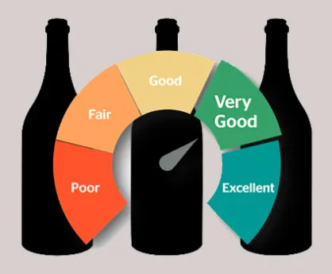
Existing system
In the traditional system:
• Salary decisions are often made manually by HR managers • Decisions may be influenced by human bias • Salary estimation is time-consuming • Lack of data-driven analysis
Limitations:
• Inconsistent salary structures • Limited transparency for employees • Difficulty analyzing large datasets

Slide 7
Proposed system
The proposed system uses Machine Learning algorithms to predict employee salaries automatically.
The system processes historical HR datasets and trains a predictive model that learns salary patterns based on employee attributes.
Key features:
• Automated salary prediction using ML • Data-driven decision making • Interactive web interface • Real-time prediction using FastAPI API • Data visualization using Chart.js

Slide 8
Objectives
Develop an AI-based system to predict employee salaries.
Analyze employee data to identify salary influencing factors.
Implement machine learning models for salary prediction.
Provide accurate and data-driven salary estimations.
Build a user-friendly web interface for predictions.

Slide 9
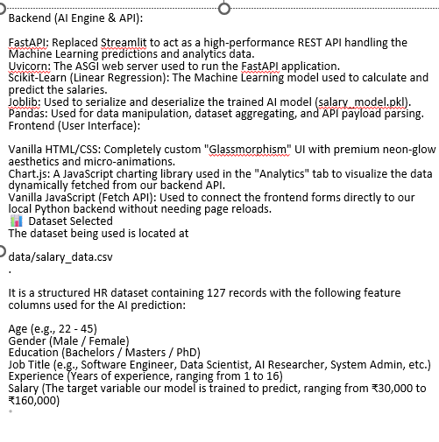
Software requirements
• Python • FastAPI • Uvicorn • Scikit-Learn • Pandas • Joblib • HTML / CSS • JavaScript • Chart.js
Tools used:
• VS Code • GitHub

Slide 10
Hardware requirements
• Processor: Intel i3 or higher • RAM: 4 GB or higher • Storage: 10 GB minimum • Operating System: Windows / Linux / MacOS

Slide 11
FUNCTIONAL requirements
The system should:
• Accept employee details as input • Process the input using the trained ML model • Predict employee salary • Display prediction results in the web interface • Provide analytics charts for data visualization

Slide 12
Non - functional requirements
• Reliability – system should provide consistent predictions • Performance – API response should be fast • Scalability – system should support more datasets • Security – API endpoints must be protected

Slide 13
Literature survey
S. No | Name of the research paper | Author name | Technologies used | Advantages/ Disadvantages
1 | Employee Salary Prediction using Machine Learning Techniques (2021) https://ijarsct.co.in/Paper29720.pdf | S. Kumar, R. Sharma | Linear Regression, Random Forest | Advantage: Accurate salary prediction using ML models. Disadvantage: Limited features like skills and company size were not included.
2 | AI-Based Salary Prediction System using Machine Learning (2022) https://www.researchgate.net/publication/371383163_Salary_Prediction_System_using_Machine_Learning | A. Patel, M. Singh | Decision Tree, Support Vector Machine | Advantage: Improved prediction accuracy using multiple algorithms. Disadvantage: Dataset size was small.
3 | Predicting Employee Compensation using Machine Learning (2020) https://ijstmr.com/wp-content/uploads/2023/04/IJSTMR_V8I04_1267.pdf | J. Brown, T. Wilson | Linear Regression, Gradient Boosting | Advantage: Provides data-driven compensation analysis. Disadvantage: Requires high-quality datasets.

Slide 14
Thank you
S. No | Name of the research paper | Author name | Technologies used | Advantages/ Disadvantages
4 | Salary Prediction using Data Mining Techniques (2023) https://www.academia.edu/145123832/Machine_Learning_Approaches_to_Salary_Prediction_in_Human_Resource_Payroll_Systems | P. Sharma, K. Verma | Random Forest, Data Mining Algorithms | Advantage: Handles large datasets effectively. Disadvantage: Model complexity increases computation time.
5 | HR Analytics: Predicting Salaries using Machine Learning (2021). https://ijsrem.com/download/salary-prediction-system-using-machine-learning/ | R. Gupta, S. Mehta | Neural Networks, Regression Models | Advantage: Identifies hidden salary influencing factors. Disadvantage: Neural networks require large training datasets.
6 | Machine Learning Approach for Employee Salary Prediction (2022) https://www.scribd.com/document/969330650/Employee-Salary-Prediction | D. Lee, M. Chen | Support Vector Machine, Decision Trees | Advantage: High prediction accuracy with structured datasets. Disadvantage: Performance decreases when features are missing.

Slide 15
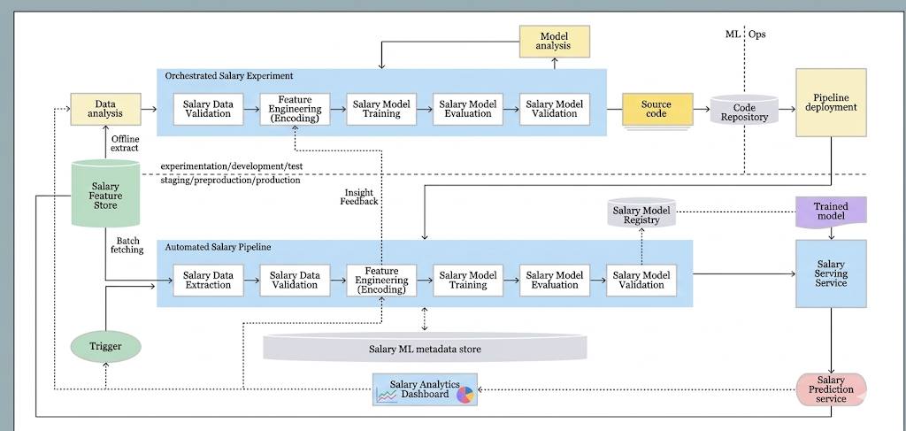
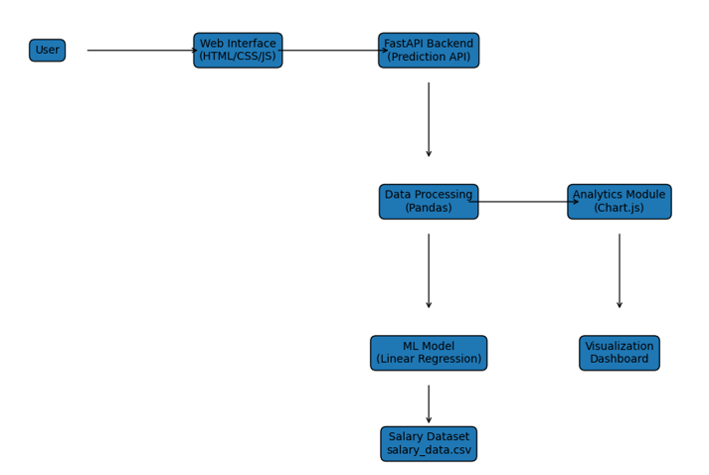
System Architecture
The system architecture of the Employee Salary Prediction System describes how different components interact to predict salaries using machine learning. The system collects user input through a web interface, sends the data to the backend API, processes it using a trained machine learning model, and returns the predicted salary with analytics visualization.

Slide 16
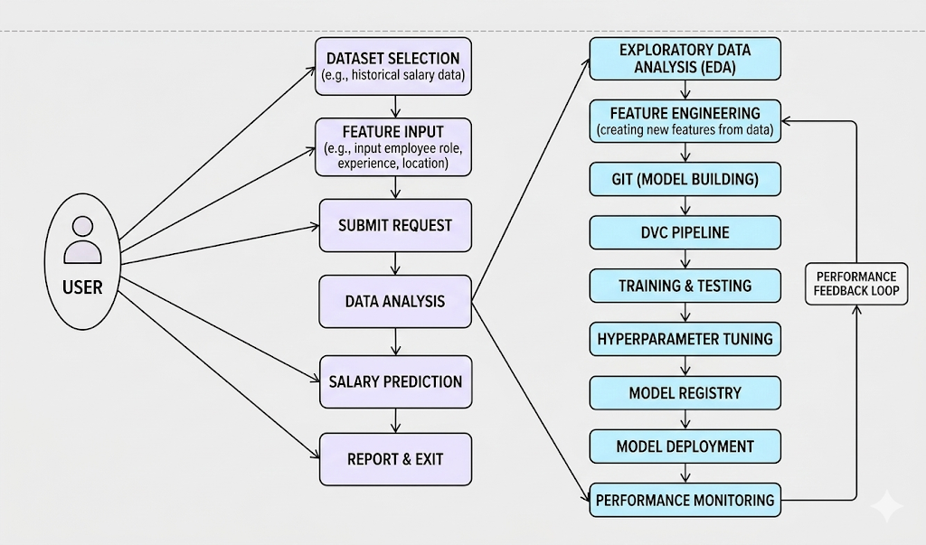
Uml diagram

Slide 17
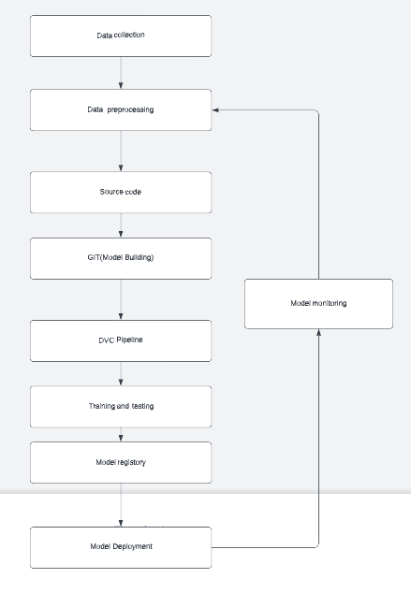
Activity diagram

Slide 18
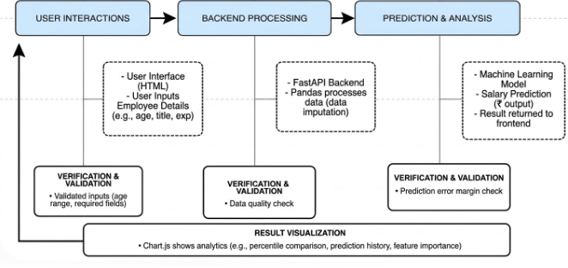
Module design

Slide 19


